Slide 1

CS231n 스터디
2022.05.24
발표자 : 서준혁

Slide 2
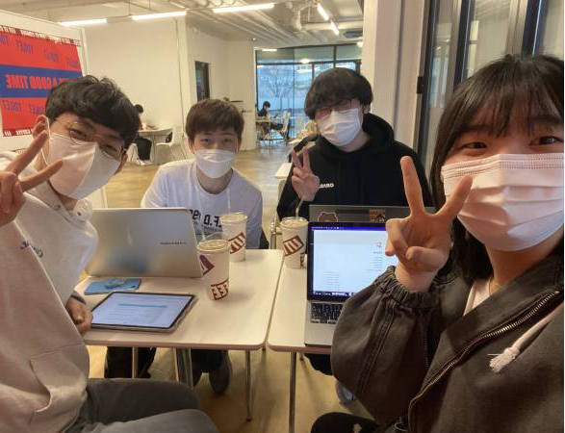
1. 스터디 진행 상황
매주 금요일. 12:30 릿잇에서
6회차 : 22. 5. 6 – 9, 10강 스터디
7회차 : 22. 5. 13 – 11, 12강 스터디
8회차 : 22. 5. 20 – 13, 14강 스터디
Lecture 9 : CNN Architectures
Lecture 10 : Recurrent Neural Networks
Lecture 11 : Detection and Segmentation
Lecture 12 : Visualizing and Understanding
Lecture 13 : Generative Models
Lecture 14 : Deep Reinforcement Learning

Slide 3
Lecture 10 – Detection and Segmentation
Semantic Segmentation
Classification + Localization
Object Detection
Instance segmentation

Slide 4
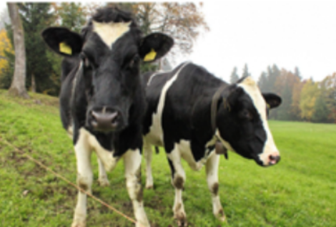
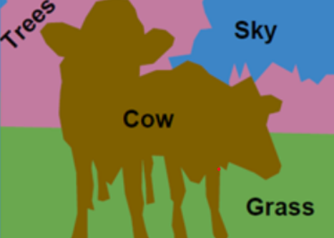
1. Semantic segmentation

Slide 5
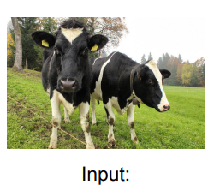
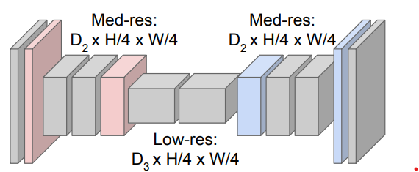
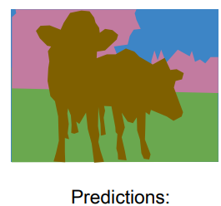
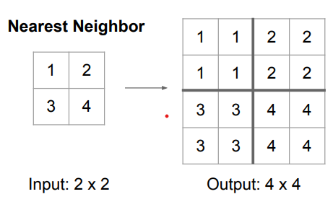
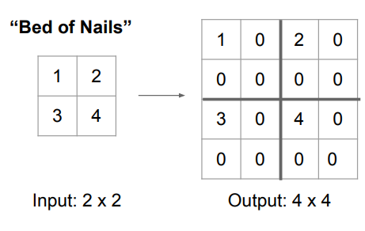
1. Semantic segmentation
Upsampling : Unpooling – Nearest Neighbor, Bed of Nails, Max Unpooling

Slide 6
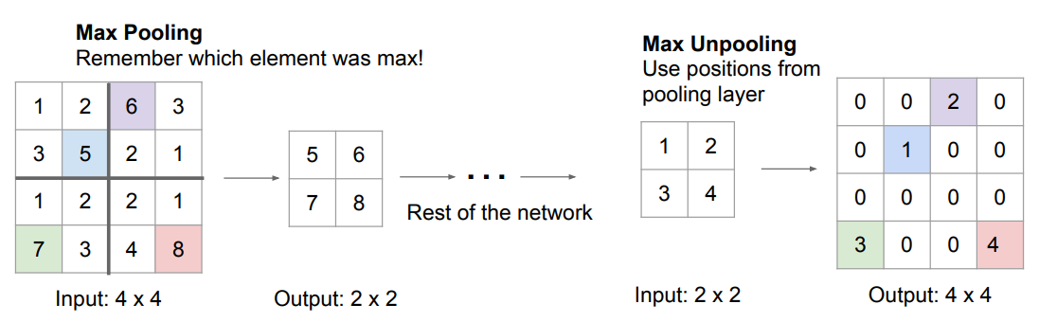
1. Semantic segmentation
Upsampling : Unpooling – Nearest Neighbor, Bed of Nails, Max Unpooling

Slide 7
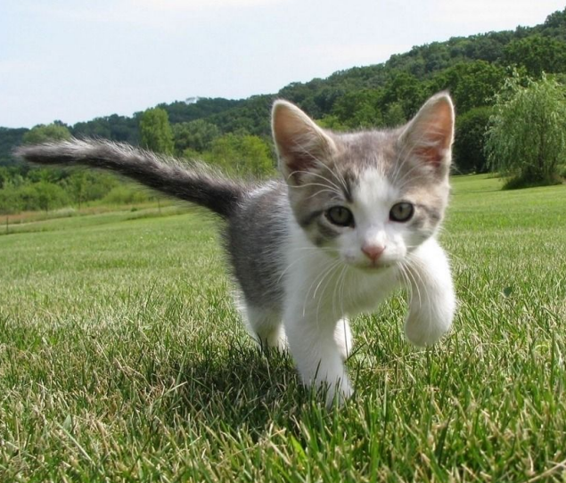
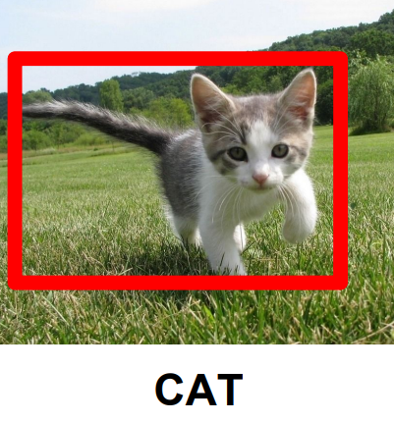
2. Classification + Localization

Slide 8
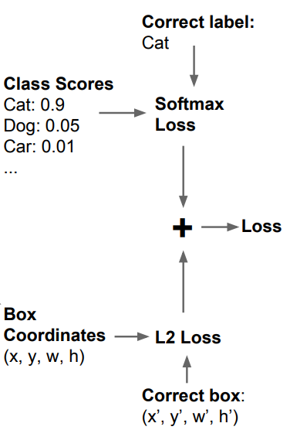
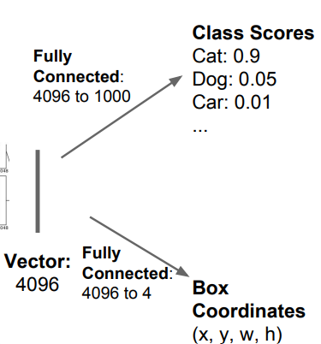
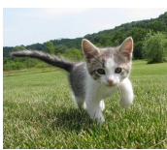
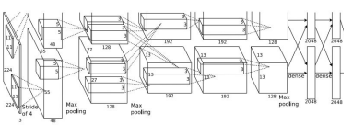
2. Classification + Localization

Slide 9
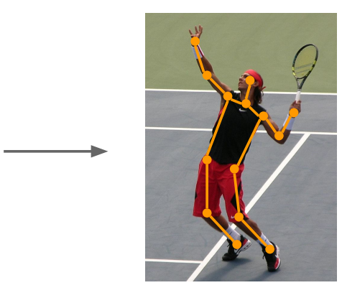
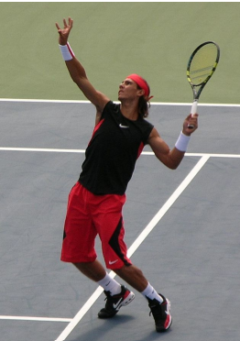
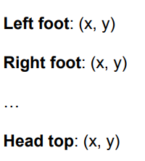
2. Classification + Localization
cf) Human Pose Estimation

Slide 10
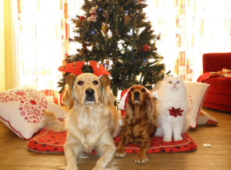
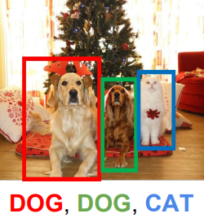
3. Object Detection

Slide 11
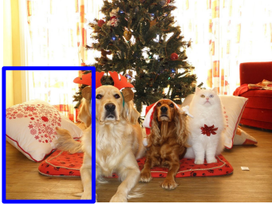
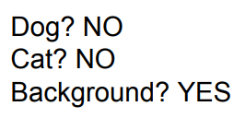
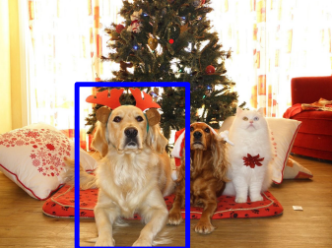
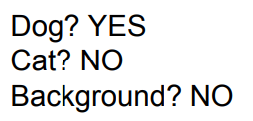
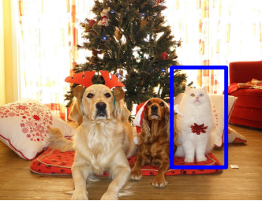
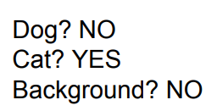
3. Object Detection

Slide 12
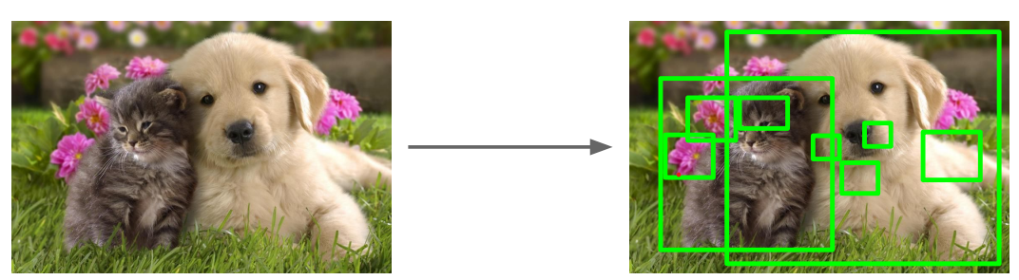
3. Object Detection
Solution : Region Proposals

Slide 13
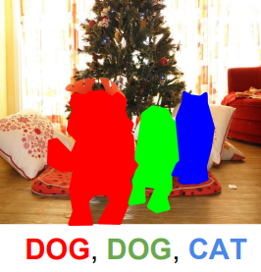
4. Instance segmentation

Slide 14
감사합니다.

